Slide 1
Introduction: New Performance Management Process
Anne Trent
HR Director
City of Cartersville
July 2022
Notes:
Hello and welcome to the Introduction on our new performance management process.

Slide 2
Performance Management-Agenda
What’s Changing
Calendar
Performance Management
Goal Setting
Quarterly Check-Ins
Next Steps

Slide 3
What’s Changing?
Performance Calendar: The new review period will now be from July 1st-June 30th.
ALL reviews completed in June: All employees’ performance reviews and ratings will be completed and communicated in June of each calendar year versus on employees’ work anniversary.
Year-Round Feedback: Goal-setting, quarterly feedback, a self-assessment, and 30-60-90-day check ins for new hires will be added to our City process.
Annual Pay Increases: Beginning with raises received in July 2023, they will consist of a hybrid of COLA and performance-based increases.
Notes:
So, let’s talk about what is changing
The performance calendar, for all full-time employees, will be 7/1-6/30 regardless of your work anniversary.
We are shifting the process from a one-time-per-year event, to a series of ongoing, smaller actions, over the course of the review period. To supplement the annual review, the performance cycle will include goal-setting, mid-year review, quarterly check-ins, and a self-assessment allowing for more real-time discussions.
Beginning in July 2023, budget permissible, annual increases will consist of two segments; one that represents the cost of living increase and one that represents the reward based on job performance. To build a high performance culture, it is important to differentiate the increase in pay given to high performers compared to lower performers, Our annual pay increase process will reflect this philosophy.

Slide 4
Annual Performance Calendar
Month | Action | Action Items
July | Goal Setting | Finalize goals for the period July 1, 2022-June 30, 2023
October | Quarterly Check-In | Review goals, adjust goals, and discuss performance for months July, August, and September
January | Quarterly Check-In | Review goals, adjust goals, and discuss performance for months October, November, and December
April | Quarterly Check-In | Review goals, adjust goals, and discuss performance for months January, February, and March
June | Self Assessment/Annual Review | Review goals and performance for the period July 1, 2022-June 30, 2023
Notes:
Here’s a look at our performance calendar.
It starts July 1st with the establishment of goals for the fiscal year.
In October, January and April you and your supervisor will sit down to review your goals
And, in June, all employees will complete a self-assessment and supervisors will complete reviews.

Slide 5
What does Performance Management mean to you?

Slide 6
Some Definitions of Performance Management…
“Simply put, performance management is a process which identifies, analyzes, and develops the performance of a workforce continuously, linking individual performance with clear objectives that – if carried out – will help the workforce reach the goals of the organization and make for a more efficient workplace.”
“The performance management process of continuous feedback and communication between managers and their employees is to ensure the achievement of the strategic objectives of the organization.”
“Performance Management is a continuous and systematic approach that ensures the achievement of organizational business goals by streamlining employee performance and efforts to match the set goals efficiently. Performance Management builds a communication system between a Manager and an employee that occurs throughout the year, in support of accomplishing the strategic objectives of the organization.”
What do these definitions all have in common?
Notes:
There are millions of definitions of performance management, and they all say pretty much the same thing. The themes in just these three definitions are continues feedback, system, process, communication. And, that is probably the biggest change, is that formally, we are moving from a one-time per year feedback session, to continuous feedback.

Slide 7
Why is a Year-Round Process Better for Employees?
Facilitates employee growth and development
Improves employee-manager relationship
Streamlines communication
Goals stay on track throughout the year
Increased engagement
Employees WANT to know how they are doing
Notes:
1. Growth & Development-With a system of continuous feedback, managers and employees will be engaged in meaningful conversations about how to improve performance. This helps create an environment where people feel like they can grow with the company as well!
2. Employee-manager relationship-We all know how important it is for employees to have a strong relationship with their manager; the more feedback they receive from him or her, the happier people will probably feel about working at that company!
4. Goals stay on track throughout the year: Being focused on continuous goal management forces managers to check in on employee progress toward established objectives. With clear milestones in place and regular check-ins, goals stay on track and attainable and employees can gain faster access to the resources they need for success.
7. Employees WANT to know how they are doing: It still comes as a shock to some but the reality is that employees want feedback. They want to know how they are doing and how to improve and some might not like waiting until the end of the year to get the feedback they need to feel acknowledged, engaged, and most importantly, completely clear about expectations.

Slide 8
Your Role as an Employee
Work towards achieving your individual goals, which helps the City reach its objectives.
Keep track of your progress on your goals and regularly communicate their status to your manager, especially if you're facing challenges that could prevent you from achieving your goals.
Know what knowledge, skills and experience you want and need to develop.
Accept constructive feedback and take the initiative to improve.
Keep a record of your performance achievements, successes and challenges.
Complete your self-appraisal by the specified deadline.
Draft your goals for the coming period.

Slide 9
Goal Setting

Slide 10
Goal Setting Period
When: July 11th-August 12th
Who: All Employees
Employee | People Manager
Reviews job responsibilities | Schedules meeting with employee to discuss goals; makes adjustments as necessary
Drafts goals | Reviews and approves goals
Submits Goal Setting form to Supervisor for approval | Sends to HR

Slide 11
7 Reasons Why Goal Setting Is Important
Motivates employees-having a specific goal to work on improves morale.
Prioritizes their work-helps the employee focus on their priorities.
Helps with Decision Making-before taking any decision, an employee will evaluate it against their goal.
Teamwork-when individual goals are linked to organizational goals, it promotes teamwork.
Measure Success-when utilizing SMART goals, the measure will help everyone evaluate the results.
Guides Employees-goals setting guides employees in moving forward in the organization. It acts as a roadmap for the employee towards achieving what they want.
Time Management-time is one of the most important resources. Helps employees to manage their time effectively.
Notes:
Let’s talk about the benefits of goal setting:
It motivates people.
It helps employees prioritize what to spend their time on.
Impacts decision-making. How will xyz impact my goal?
For teams, a goal brings them closer as they work toward a common objective.
Measures success-

Slide 12
SMART Goals-What are they?

Slide 13
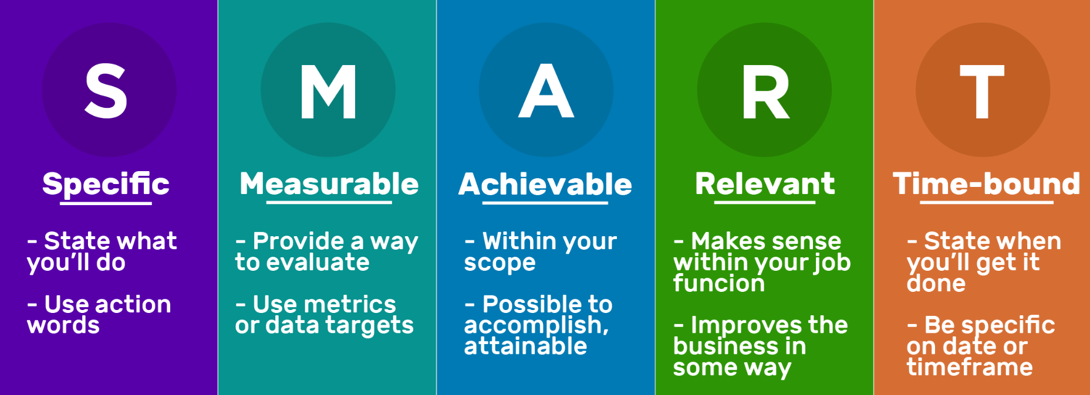
SMART Goals
Notes:
First things first, what are SMART goals? SMART goals are an approach to goal-setting that will help you set a clear, and realistic path to success. And, the SMART part about SMART goals is actually an acronym that stands for Specific, Measurable, Achievable, Relevant, and Time-Bound. So, let’s talk a little bit more about that.
What do we mean by Specific? When we say specific, we want to define the outcomes and deliverables. Define what you plan to deliver using action verbs.
To make those goals measurable, we need to identify how we will measure success which will help keep us on track.
To keep our goals achievable, we need to make sure that our goals are practical and within grasp. They must be realistic for, both, ourselves, and our team members.
Relevant goals should be relevant to your departmental goals, or the City goals.
And, to set timely goals, we nee to set realistic deadlines.

Slide 14
Things to consider when creating a SMART Goal
SMART Goals Steps | Crafting a Goal Statement
Initial Goal | Write the goal you have in mind.
Specific | What do you want to accomplish? Who needs to be included? When do you want to do this? Why is this a goal?
Measure | How can you measure progress and know if you’ve successfully met your goal?
Attainable | Do you have the skills required to achieve the goal? If not, can you obtain them? What’s the motivation for this goal? Is the amount of effort required on par with what the goal will achieve?
Realistic | Why am I setting this goal now? Is it aligned with the overall objectives?
Time-Bound | What’s the deadline and is it realistic?
SMART Goal | Review what you have written and craft a new goal statement based on what the answers to the questions above have revealed.
Notes:
So, what does a SMART goal look like and how do you create one?
Let’s take a look at the types of questions you can ask yourself as you are drafting your SMART goals.

Slide 15
SMART-ER Goals
SMART Meaning | Example #1
Specific: Make sure you define your goal carefully and clearly. | For example, a goal could be organization, but a specific goal could be organization of your cubicle.
Measurable: Include something in your goal that you can measure | …such as a goal of organizing your desk, filing cabinet and floor within three months.
Achievable: Find a goal that you are likely to meet with your current schedule. | If you want to organize your filing cabinet this month, make sure you have enough time each week to clean and organize one of the four drawers.
Realistic: Ensure that you can actually meet the goal. | Choose to organize one area of your workspace per week, rather than the entire cubicle, for example.
Time-bound: Give your goal a time frame so that you can plan for your success. | For example, if you plan to finish organizing before the first day of the next quarter, you know when you need to complete your last task to succeed at this goal.
Evaluate: Choose a regular time to check on your goal's progress. | For example, check every two weeks to be sure you have made progress on your project in order to achieve your goal.
Readjust: Be prepared to change your plan as needed. | If you get assignments that require overtime, for instance, be flexible and spread your project over the week instead.
Notes:
Let’s take a look at an example that utilizes SMART goal approach.
This example is about organization.

Slide 16
More Examples of What SMART Goals Look Like…
Not a SMART Goal | SMART Goal | Specific | Measurable | Achievable | Relevant | Time Bound
Provide good service to customers. | Increase Customer Satisfaction score to 90% this year. | √ | √ | √ | √ | √
Be safe on refuse truck. | Incur zero injuries on refuse trucks in FY 2022-2023. | √ | √ | √ | √ | √
Mow sports fields regularly. | Mow sports fields once per week in the Spring and Summer months. | √ | √ | √ | √ | √
Obtain my CDL. | Take and pass the test to obtain my CDL by Nov 2022. | √ | √ | √ | √ | √
Learn a new skill. | Learn Microsoft Excel by completing a course by Q4 2022. | √ | √ | √ | √ | √
Notes:
Let’s take the goal, provide good service to customers. This is a good starting point, however, it’s not SMART. In fact, it’s not specific, nor measurable, and it’s definitely not timely. Our SMART goals need to be objective-based, not action based, and we need to have a clearly defined result to help motivate ourselves and out team towards our goal.
What would this look like if it were a SMART goal? How about, increase customer satisfaction score to 90% this year. This is a great SMART goal. It’s in line with the initial goal of providing good customer service while providing a specific and measurable outcome that’s achievable and relevant. It also sets a target date to help keep us motivated and help measure our progress.

Slide 17
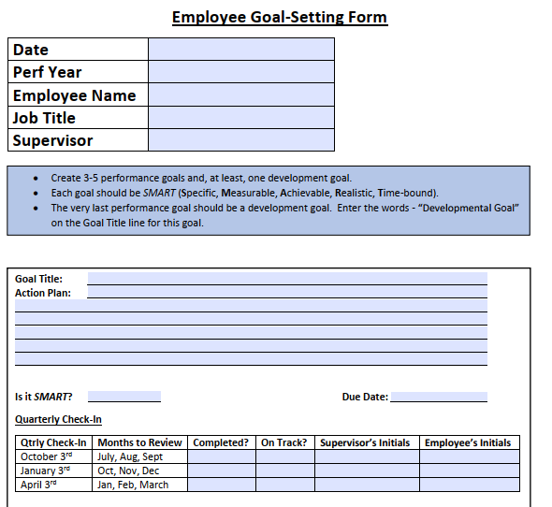
Goal Setting Form
Notes:
Let’s take a look at the Goal Setting form. This is a “fillable” form which means you will be able to enter the information directly into the document. If you do not have access to a computer, your manager can provide a paper copy that you can fill out manually.
At the top of the form is an are for your employment information.
Next, you will see some instructions. As the form mentions, employees should stick with 3-5 SMART goals. More than 3-5 goals can not be achieved successfully. One of the goals should be a development goal. So, maybe you want to learn a new skill, take a class on excel, etc.
In the form you will see a “Goal Title” box where you will write your SMART goal. As I mentioned earlier, it might be best to finalize your goals with your supervisor, then, once finalized, you enter them on the goal setting form.
Next, is the action plan. Here you will list out how you will carry out this goal. What resources do you need, what budget do you need, etc.
There is an area to check off that confirms it is a SMART goal and the due date.
The due date can be at any point throughout the performance period. Some goals may be due sooner in the year than others.
Next, you will see the quarterly check-in box. So, as you meet with your supervisor in October, January, and April, you and your supervisor can check off that you have met and what the status of your goals are. At the quarterly check-ins is where you will assess how you are tracking on your goals and make any adjustments. You supervisor should help offer assistance with removing any roadblocks.
You and your supervisor will sign off that you met, and they can either email the document to you, or provide a manual copy for your records.

Slide 18
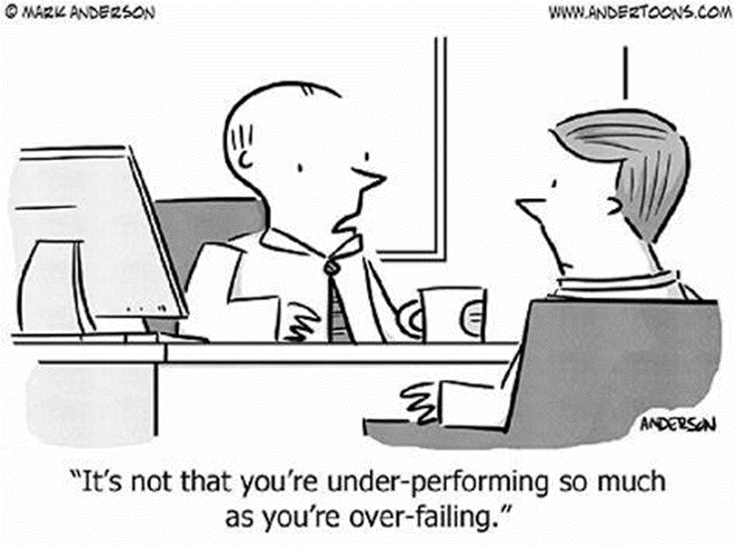
Quarterly Check-Ins

Slide 19
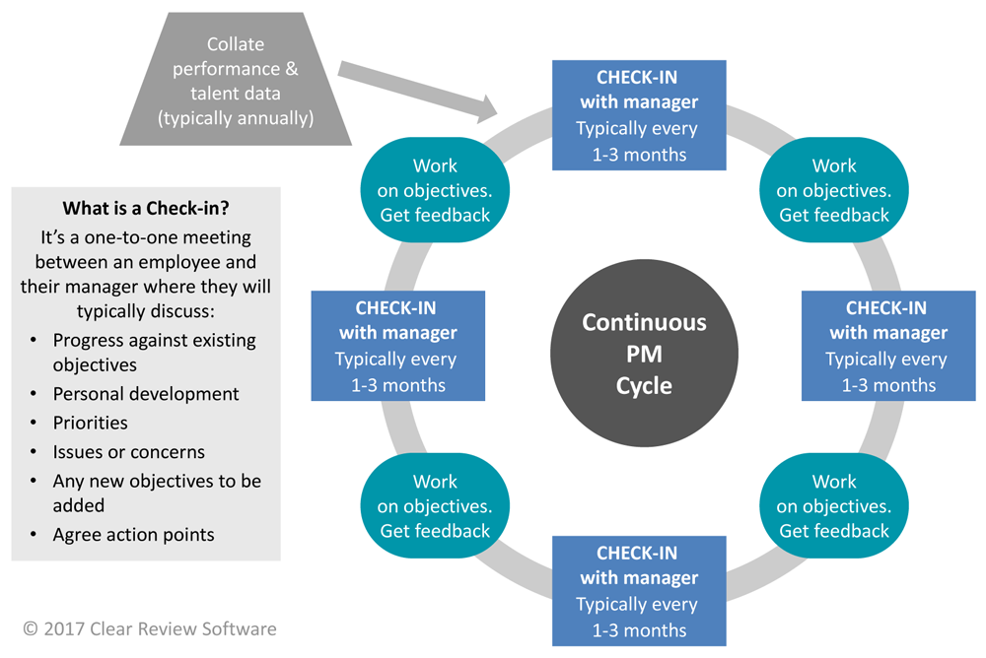
What is a Check-In?
Notes:
So, what is a check-in? Probably seems self-explanatory, but as this slide states, it’s a one-on-one meeting between an employee and their supervisor/manager to touch base on general performance, goals, professional development, removing roadblocks, acts as a pulse-check for the supervisor to gauge an employees’ engagement/happiness. It’s also a great opportunity for the employee to bring up any concerns.
You will see the quarterly check-ins play a major role in the continuous feedback loop.

Slide 20
What are the tangible organizational benefits to check-ins?
Organizations who man­age objec­tives quar­ter­ly gen­er­ate 30% high­er returns than organizations who address them annually.
Fre­quent feed­back has been shown to boost per­for­mance by up to 39%.
A study by Gallup has also found that employ­ees whose man­agers hold reg­u­lar one-to-ones with them are almost three times as like­ly to be engaged.
Research has found a 14.9% lower turnover rate in employers that provide regular feedback.
68% of employees who receive accurate and consistent feedback feel fulfilled in their jobs.
63% of Gen Z said they want to hear timely, constructive performance feedback throughout the year.
Notes:
I thought it was interesting to see that there are returns on investment when continuous feedback is given.
Some that stand out to me are: employees are three times as likely to be engaged when receiving regular feedback, 14.9% lower turnover rate, 68% feel fulfilled. And, 63% of Gen Z want timely feedback throughout the year. By 2025, Gen Z will make up 27% of the workforce. I say that to point out that it is important that employers manage to the generations they are employing.

Slide 21
Next Steps
Begin a first draft of your goals. All employees will draft their goals and then, submit them to their manager for review and edits. Employees can email their goals to their Supervisor. They can be edited and finalized over email. Then, once in their final state, be transferred over to the Goal-Setting form.
Supervisors will meet with their direct reports to review goals. To kick off this performance year, the employee and Supervisor will discuss the goals. The Supervisor will ensure the employee has the tools they need to be successful.
Supervisors will schedule the initial goal-setting meeting and quarterly check-ins. Either through Outlook, or verbally (in cases where there is no computer access), the Supervisor will coordinate the initial meeting and all quarterly check-ins.
Notes:
So, let’s talk about next steps…

Slide 23
References
Training ABC
https://employee-performance.com/blog/7-benefits-of-year-round-employee-performance-management/
Make Your Performance Appraisals Part of a Year Round Performance Management Plan – TrainingABC
What Is Continuous Performance Management? | Clear Review
https://www.linkedin.com/pulse/roles-responsibilities-best-practice-performance-management-phil-pote/
Five Best Practices for Effective, Year-round Performance Management (mgassessments.com)
10 Effective Goal-Setting Techniques for Achieving Your Goals | Indeed.com
https://engagedly.com/7-reasons-why-goal-setting-is-important/
What is Performance Management Definition, Types, Purpose, Objectives in HRM? (hrhelpboard.com)
17 Mind-Blowing Statistics on Performance Management and Feedback (clearcompany.com)
https://www.linkedin.com/pulse/roles-responsibilities-best-practice-performance-management-phil-pote/
(8) Benefits of Continuous Feedback in employee performance | LinkedIn
Understanding the Benefits of Continuous Feedback | TalentGuard

